Slide 1
Crowd Funding Seminar
201920951 소프트웨어학과 김주안

Slide 2
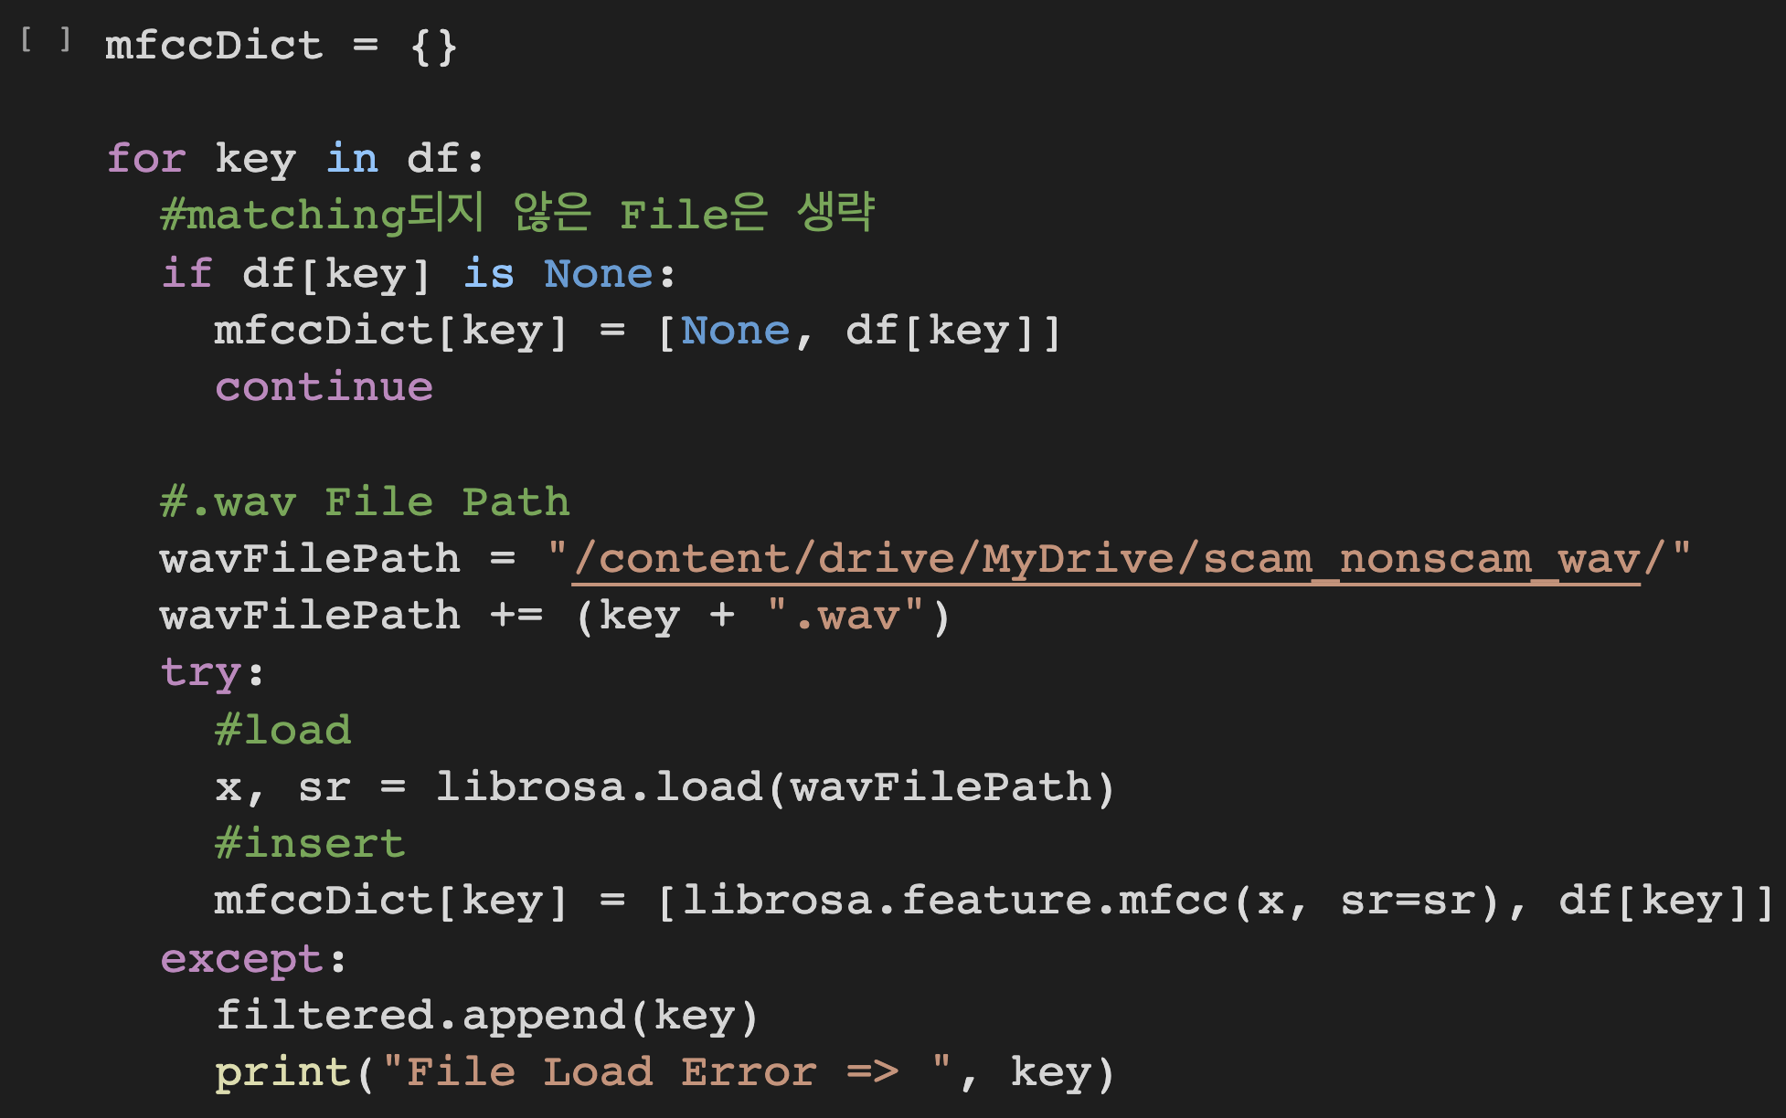
Insert Non Matched Title

Slide 3
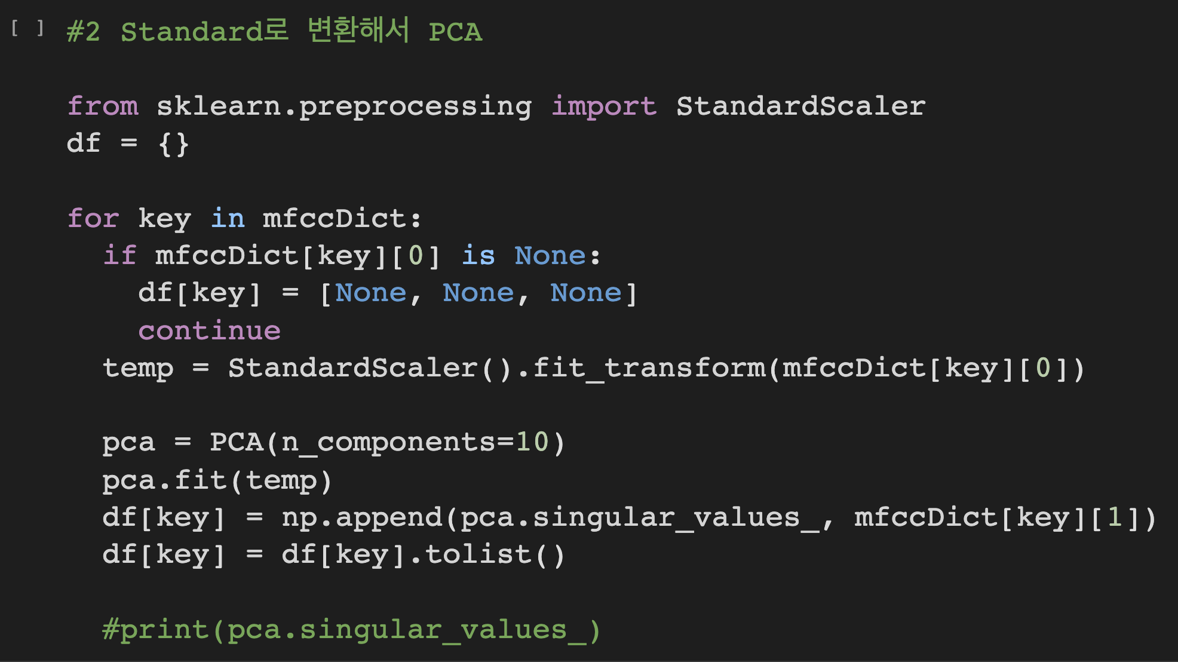
Principle Component Analysis

Slide 4
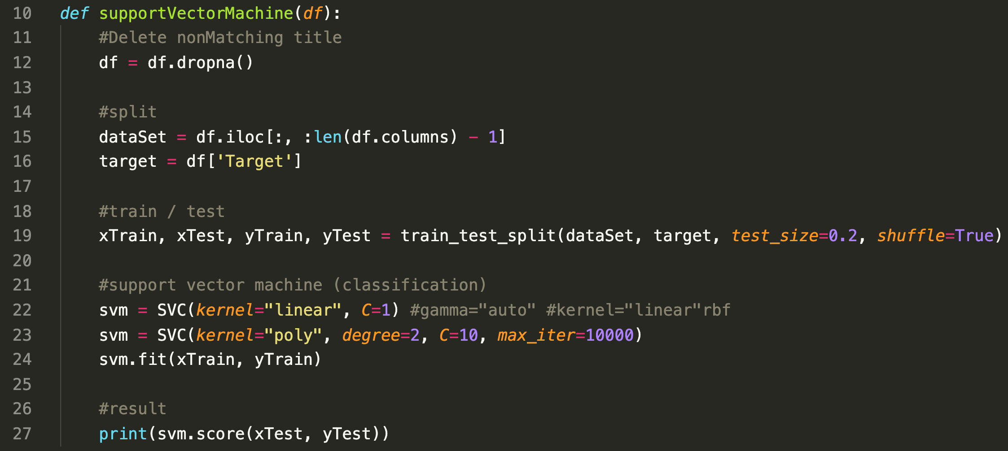
Support Vector Machine Code

Slide 5
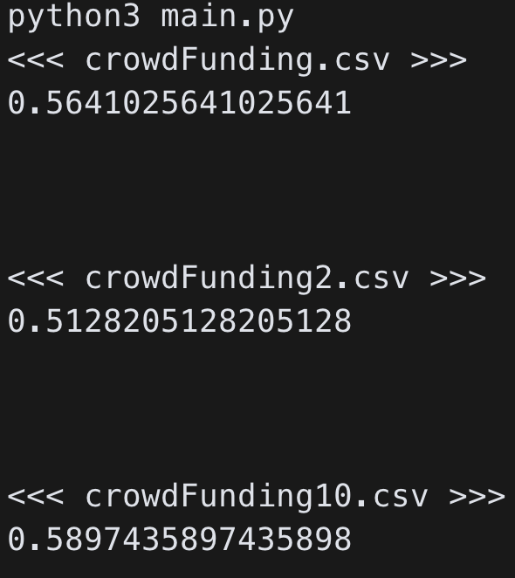
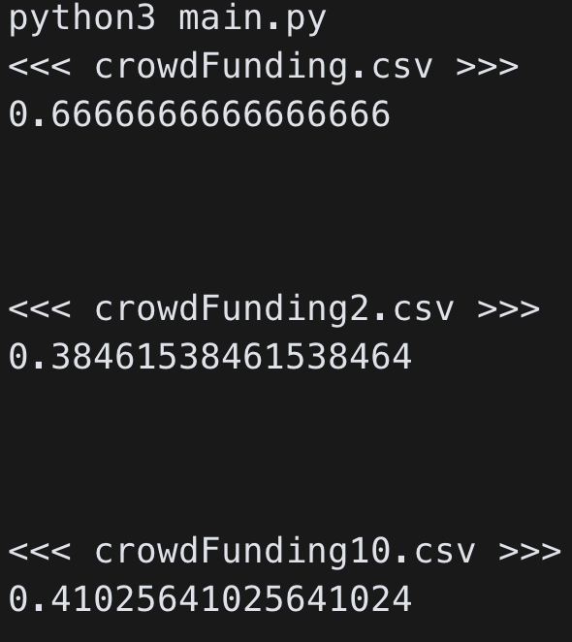
Each Case Accuracy - Linear

Slide 6
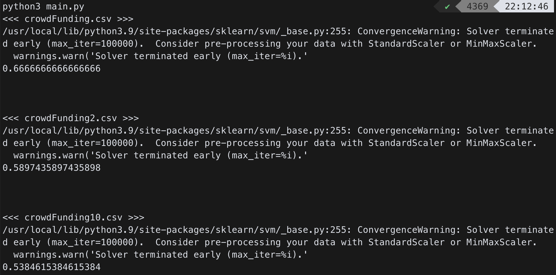
Each Case Accuracy - Poly

Slide 7
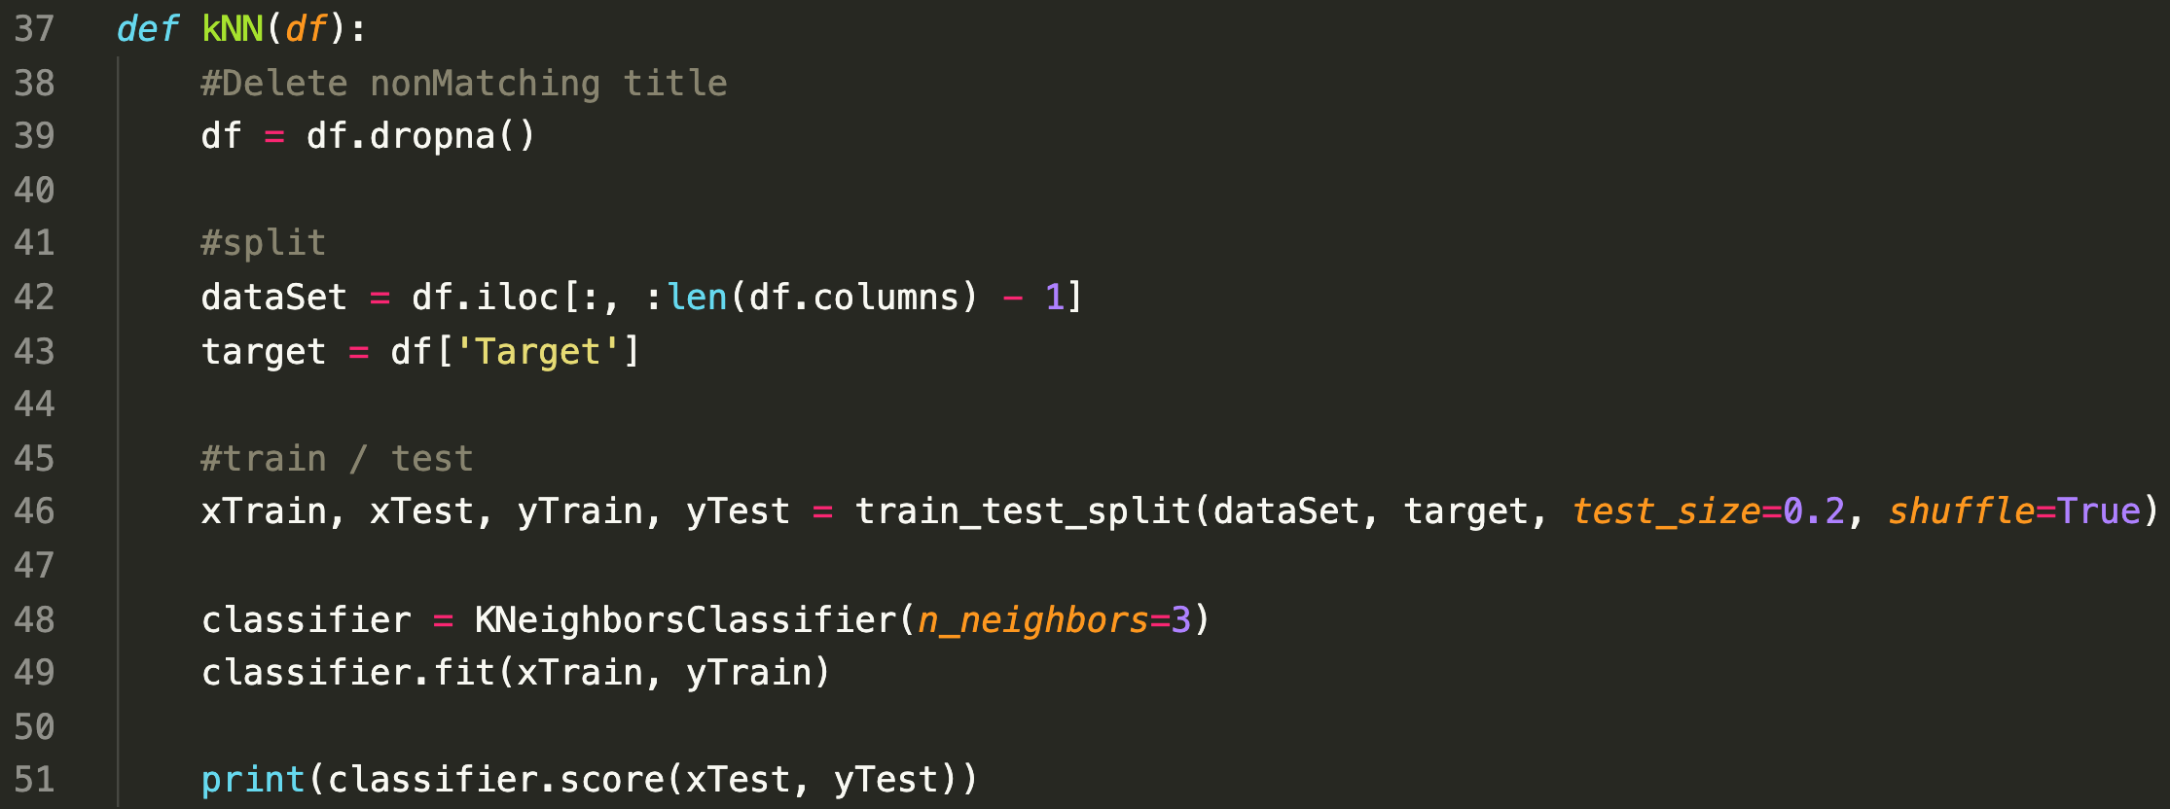
K nearest neighbor

Slide 8
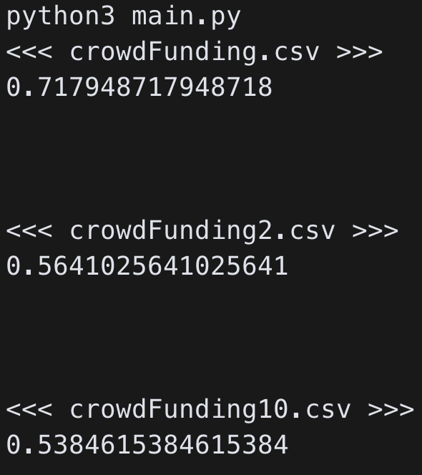
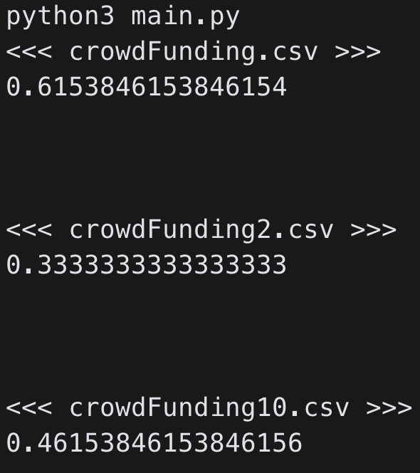
Each Case Accuracy – 3 & 4

Slide 9
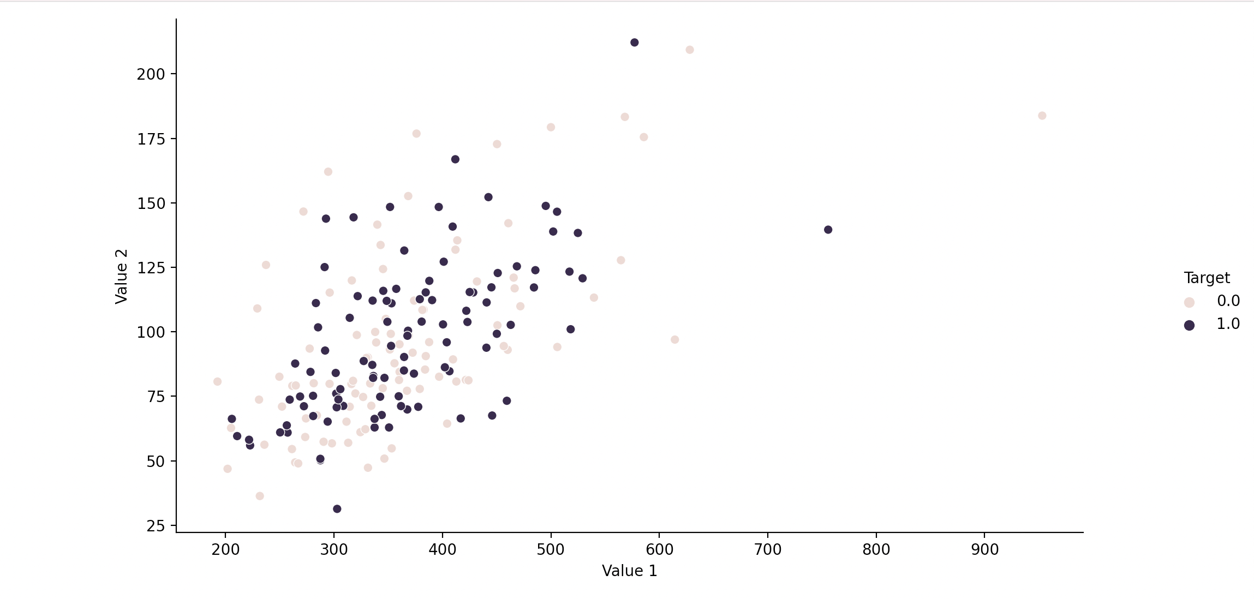
Visualization

Slide 10
Thanks For Watching
201920951 소프트웨어학과 김주안

